Slide 1
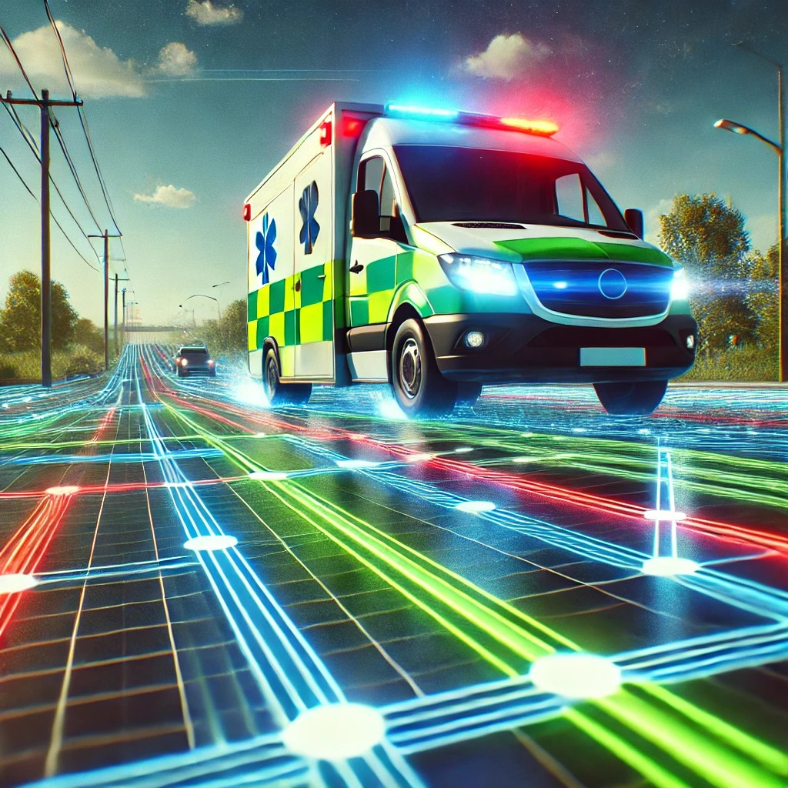


Madadgaar
Autonomous dispatching and tracking of rescue ambulance

Slide 2
Our Project Team and Guides
Our Project Team
Supervisors and Mentors
Dr Abdul Jaleel
(Supervisor)
Mr Shehzad Aslam
(Co-supervisor)
M Saadullah Zafar
(2021-CS-414)
Hafiz Abdul Samad
(2021-CS-433)

Slide 3
Introduction
Madadgaar is an innovative mobile app that provides quick access to emergency medical services. It enables users to contact emergency services easily, with autonomous ambulance dispatching and live tracking for real-time updates. The app features an AI chatbot and useful resources, offering immediate medical guidance until professional help arrives. Supported by Rescue 1122 Gujranwala, Madadgaar aims to improve emergency response and save lives through technology.

Slide 4
Problem Statement
Overburdened emergency services lead to late responses due to high demand and operational inefficiencies.
Lack of public awareness on basic first aid and emergency protocols leaves many unprepared in urgent situations.
Insufficient real-time information cause delays and confusion during emergencies.

Slide 5
Features
Autonomous Dispatching: System will select suitable ambulances automatically and dispatch them.
Autonomous Tracking: System will provide live tracking of ambulances to user app.
Chatbot: App will provide a chatbot helping user in urgent basic medical aid.
Medical blogs: App will feature blogs helping users in maintain their health and training them for first aid.

Slide 6
Implementation Methodology
Frontend
Mobile App: Developed using Flutter for user interface and experience.
Web App: Flutter-based web app for admin and control center functionalities.
Backend
Server: Node.js for handling API requests and business logic.
Database & Authentication: Firebase for real-time database and user authentication.
Cloud Services: Google Cloud Services for scalable infrastructure and additional services.

Slide 7






System Workflow
Live Tracking
User reports an emergency
Ambulance Dispatcher
User Interface
Sever Endpoint
Valid Request
Finds suitable ambulance
Ambulance & crew
along with GPS coordinates
Route
optimization
Route optimization service
Chatbot and helping material

Slide 8
Conclusion
Madadgaar uses a modern tech stack to deliver quick and reliable emergency services. With mobile and web apps, robust backend support, and cloud infrastructure, including Google Cloud, the system enhances emergency response and user experience. This integrated approach ensures timely assistance, helps save lives, and positions Madadgaar as a fundamental service in the development of smart cities.

Slide 9
Jazaak Allah
For listening us with extreme patience

